Slide 1
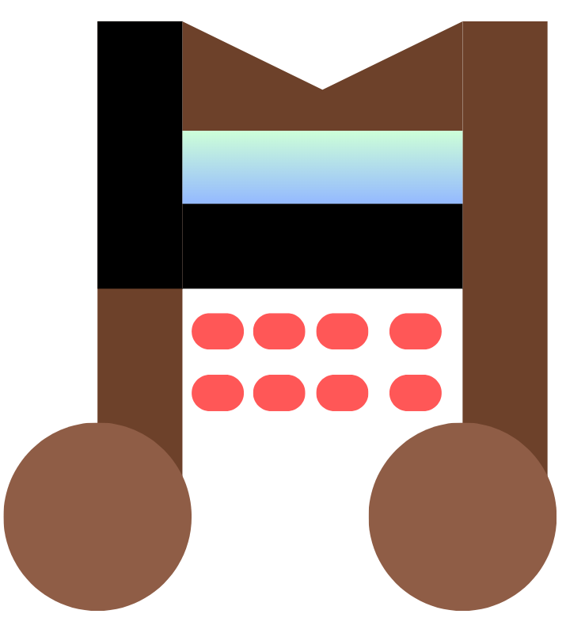
ModuLoop
Team 28 MDR: Conor Curtin, Evan Rovelli, Ryan Gordon, Shawn Colby
Advisor: Baird Soules
Evaluators: Professor Anderson & Professor Lorenzo
Notes:
Handout - 2 slides/page

Slide 2

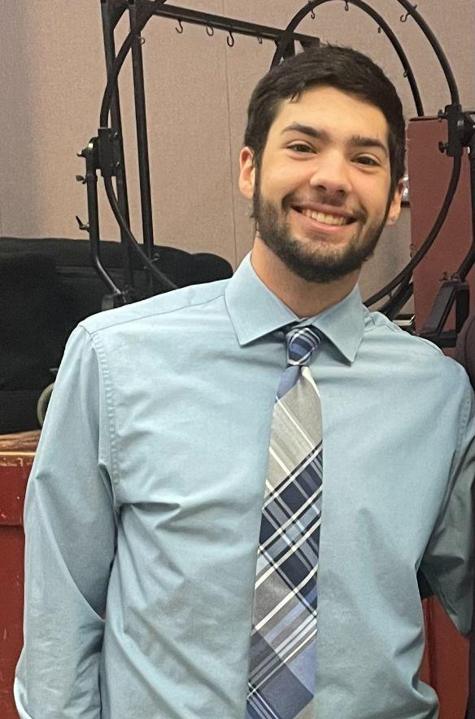


Team
Shawn Colby
Computer Engineering
Ryan Gordon
Electrical Engineering
Conor Curtin
Computer Engineering
Evan Rovelli
Computer Engineering

Slide 3
Problem Statement
Music creation has evolved over time and a lot of new technology has been incorporated into this process. There are many solutions designed to create backbeats and loops to aid musicians in creating music. However, a lot of these tools only have set features and are quite confusing for an inexperienced user to operate.
We have decided to design a solution that is more modular in its features and easier for the user to operate. Our device will be able to have varying steps for each beat in a looping measure. There will be different sounds and effects that can be swapped by the user to achieve various styles of music. The loops will be chainable, so multiple measures of music can be made.
Notes:
Ryan

Slide 4

Goal
We aim to develop a music sequencer that can use custom imported sounds along with sounds from a MIDI library to provide a user friendly, handheld platform used as a creative tool early in the production process of making music.
Notes:
Shawn

Slide 5
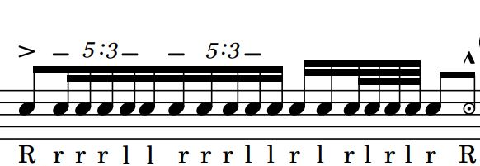
Terminology
Step - Moment in time when sound is output
Beat - Combination of one or more steps of equal length in succession
Measure - A collection of one or more beats in succession
Loop - A collection of one or more measures that is repeated
Tempo - The frequency at which beats occur in beats per minute (BPM)
MIDI - Standardized protocol & instrument library without defined sounds for music-making devices
General MIDI - Standardized instrument library with defined sounds
Notes:
Conor

Slide 6

Specifications
Specification | Test Plan
Produce accurate tempo down to smallest step interval within +/- 2% | Measure delay between steps and view output on an oscilloscope to measure the distance between peaks
High and low pass filters can be applied to final audio mix | Read effect of HPF & LPF in frequency domain using FFT oscilloscope feature
BPM is adjustable through a user input | Measure delay between steps and view output on an oscilloscope to measure the distance between peaks
Graphical user interface can be used to navigate preset & custom sound libraries and saved pattern configs | Navigate sound libraries and saved configurations
System is operable by both rechargeable battery and power supply | Independently demonstrate system powered from external power supply and battery
Notes:
Evan - 10 specifications
Think about how we are testing metronome accuracy
Metronome overlay? Record difference to metronome
UPDATE TEMPO ACCURACY
(60,000 mili-seconds)/((tempo (beat/min))*(steps/beat)))=83.333ms step interval
+/- 1.667 ms

Slide 7
Specifications Cont.
Specification | Test Plan
Allow user interchangeable custom sound files | Play custom sound files from external storage
Achieve at least four sounds layered per step | Mix minimum four sounds concurrently
Preset and custom sounds can be mixed together | Output mixed preset and custom sounds
System outputs to built-in speakers or line out | Display system sound through headphones or speakers
Device under the dimensions of a large tablet (under 13x13 inches) | Footprint dimension comparison
Notes:
Evan

Slide 8
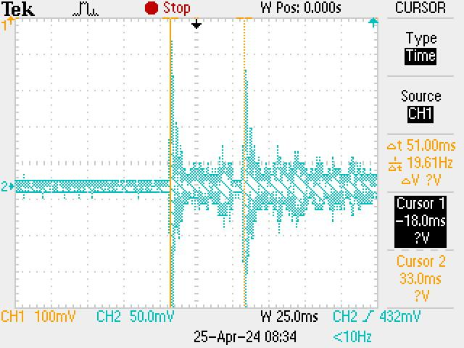
Demonstration of Timing Accuracy
Spec: +/- 2% difference in step timing
200 BPM with 6 steps/beat = 50ms / step
Tested with oscilloscope:
Assigned staccato sound to two consecutive steps
Measured delay between peaks
51ms / step => 196 BPM
2% difference

Slide 9
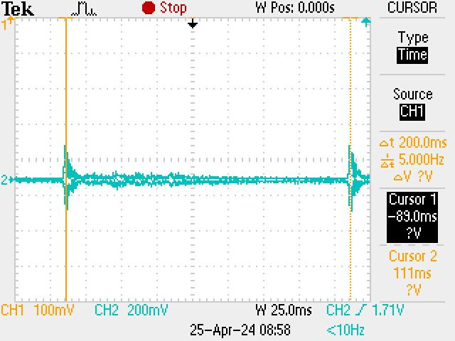
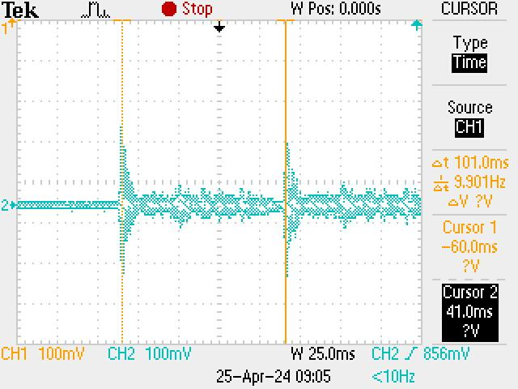
Demonstration of Timing Accuracy Cont.
Spec: BPM adjusted with potentiometer
100 BPM w/ 6 steps = 100ms / step
Tested: 101ms / step = 99 BPM => 1% difference
50 BPM w/ 6 steps = 200ms / step
Tested: 200 ms / step
= 50 BPM
=> 0% difference

Slide 10
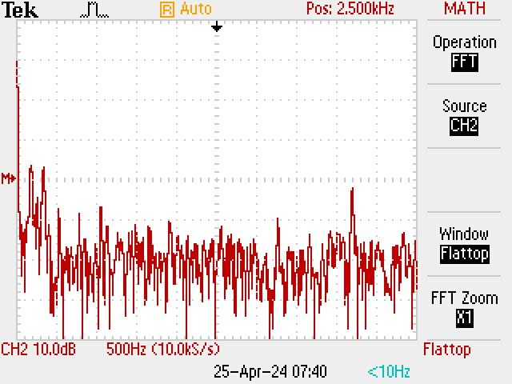
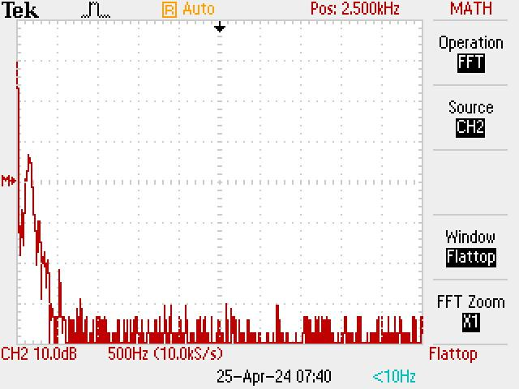
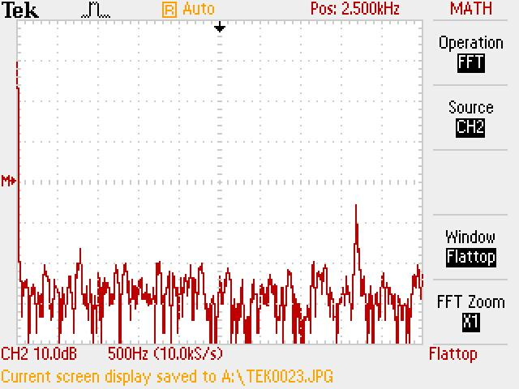
Demonstration of Filter Accuracy
Measured using FFT on oscilloscope
LPF cutoff = 300Hz
HPF cutoff = 3kHz
No Filter LPF HPF

Slide 11
FPR Deliverables
System outputs to an audio Jack or built in speakers
Save and load a created track
Deletion capabilities of last sound, all sounds on step, and all sounds on measure
Revised high and low pass filters
Increased signal decoupling
Revised amplifier selection
Revised decoder wiring
Fully packaged enclosure under 13’” by 13”
Ability to adjust the beats per measure and steps per beat
Play/Pause and deletion capabilities
Notes:
Add LED lights on step played, and palette button pressed

Slide 12
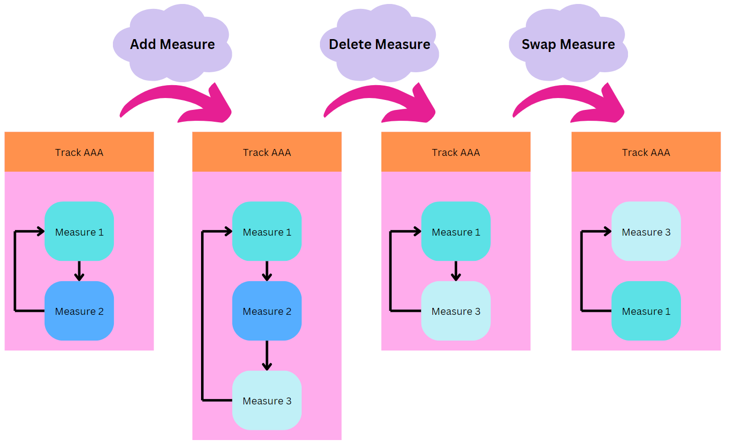
Measure Chaining and Tracks
Tracks
Every track can be thought of as a project
Within each track, we can chain measures together to create larger pieces of music
We can add and delete tracks to drop or start new chains of measures
Notes:
Evan

Slide 13
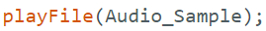
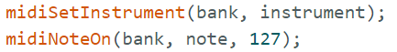
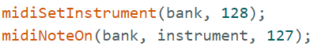
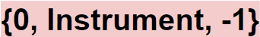
MIDI and SD Sounds Storage Methods
MIDI Melodic
All sounds stored in bank 1
Volume always set to 127 (max volume)
Each instrument has int associated
To play sound:
Set instrument to on
Call desired bank, note and volume
{1, Instrument, Note}
MIDI Percussion
All sounds stored in bank 0
Volume always set to 127 (max volume)
One Percussion “Instrument”
When turning on the sound, use the instrument value in the note parameter
To play sound:
Set instrument to on
Call desired bank, note and volume
SD Sounds
SD sounds are stored in audio sample objects on external PSRAM
To play sound: just call playFile function with desired audio sample cached on the PSRAM
{Audio_Sample}
Notes:
Shawn

Slide 14
Display to Palette to Measure Matrix
Display
MIDI Melodic:
{1, instrument, Octave, Note}
MIDI Percussion:
{0, instrument, -1}
SD Sound:
{Audio_Sample}
Palette
MIDI 2D Array:
{{1, 32, 60}, {-1,-1,-1}, {0, 40, -1},
{1, 45, 50}, … }
SD 1D Array:
{Crash, Bang, nullptr,
Guitar … }
Measure Matrix
MIDI 2D Array:
{{1, 32, 60, -1,-1,-1,...},
{0, 40, -1, 1, 45, 50,...},
{-1, -1, -1, -1, -1, -1,...},
…}
SD 2D Array:
{{Crash, nullptr, nullptr, nullptr},
{Crash, Bang, Guitar, nullptr},
{nullptr, nullptr, nullptr, nullptr},
…}
Notes:
Shawn
Mention what -1 means

Slide 15
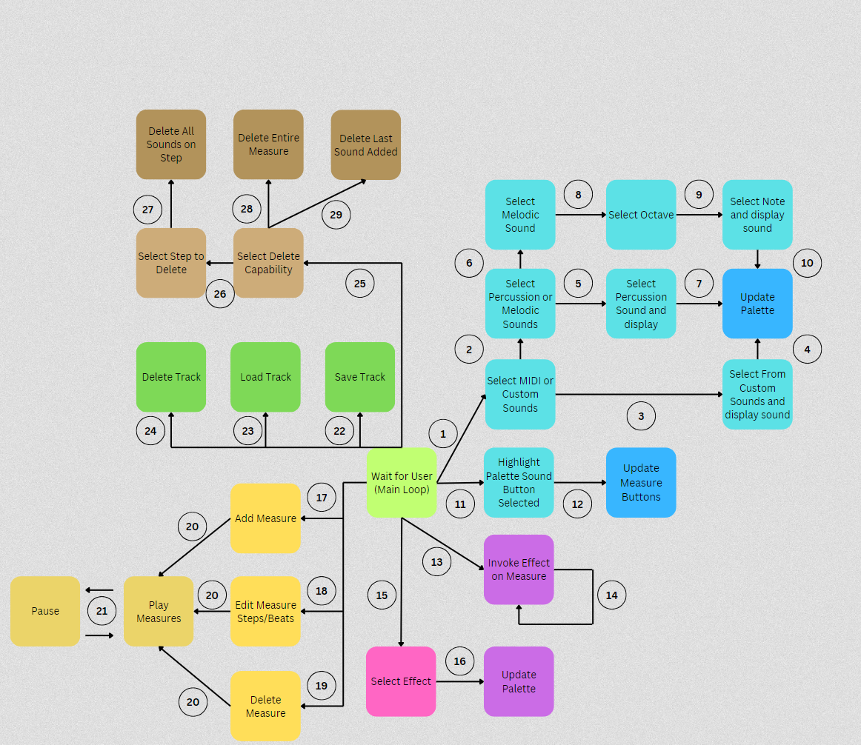
Software Block Diagram
Key
Select Sounds through display
Select MIDI sounds through display
Select Custom sounds through display
Select desired sound then a Palette button is selected
Select Percussion sounds through display
Select Melodic sounds through display
Select desired sound then a Palette button is selected
Select desired sound through display
Select desired octave through display
Select desired note then a palette button is selected
Palette button containing a sound is selected
Measure Matrix button is selected
Palette button containing an effect is selected
Loop until button is released
Select Effects through display
Select desired effect then a Palette button is selected
Select to add a measure through the display
Select how many steps for each beat play on a measure through the display
Select to delete a measure through the display
Continue playing track with measures’ updates
Pause/Play button selected
Select save track through the display
Select load track through the display
Select delete track through the display
Select delete sounds option through the display
Select delete all sounds on a step through the display
Measure matrix button selected
Select delete entire measure through the display
Select delete last sound added through the display
Notes:
Shawn
Cache that answer Shawn

Slide 16
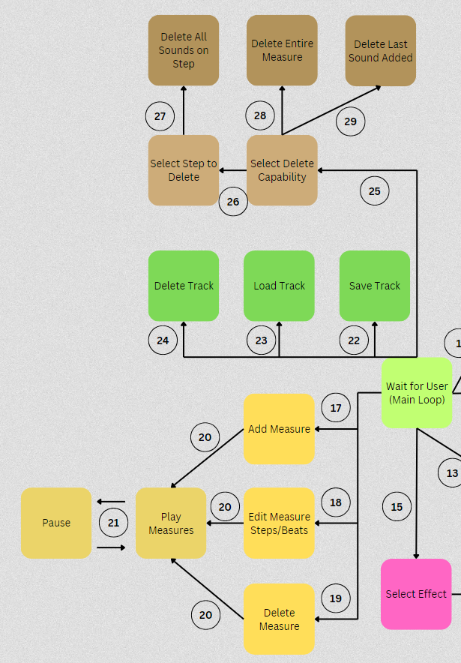
New Additions to Software Block Diagram
Key
17. Select to add a measure through the display
18. Select how many steps for each beat play on a measure through the display
19. Select to delete a measure through the display
20. Continue playing track with measures’ updates
21. Pause/Play button selected
22. Select save track through the display
23. Select load track through the display
24. Select delete track through the display
25. Select delete sounds option through the display
26. Select delete all sounds on a step through the display
27. Measure matrix button selected
28. Select delete entire measure through the display
29. Select delete last sound added through the display

Slide 17
Effects and Deletion
Effects
Repeat return
Repeat continue
Reverse
Echo (new)
Mute (new)
Scratch (new)
Double step (new)
Deletion Capabilities
Delete last sound added
Delete whole measure
Delete all sounds on a step
Requires user to select which step they would like to delete all sounds from by pushing measure matrix button

Slide 18
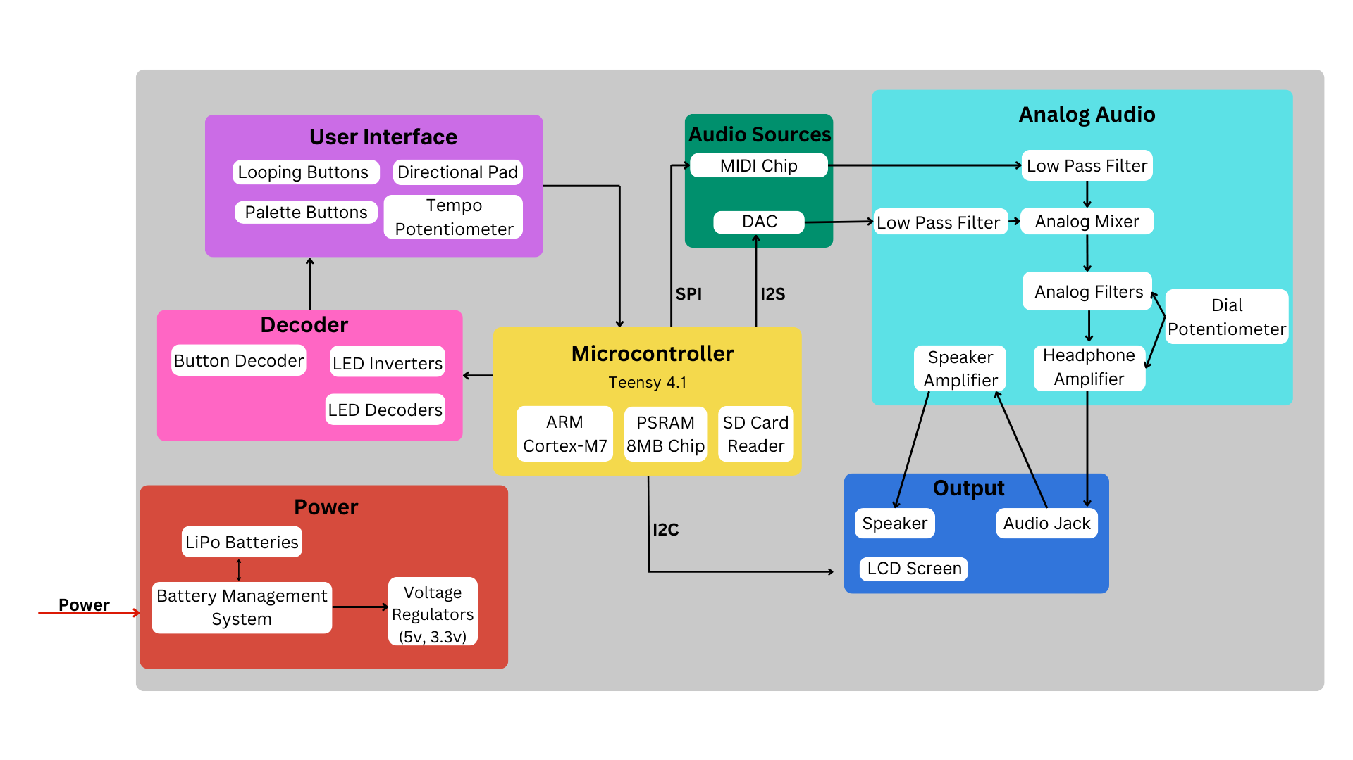
Hardware Block
Diagram
Notes:
Ryan
Specify processor details
Hardware photos after/ overlay

Slide 19
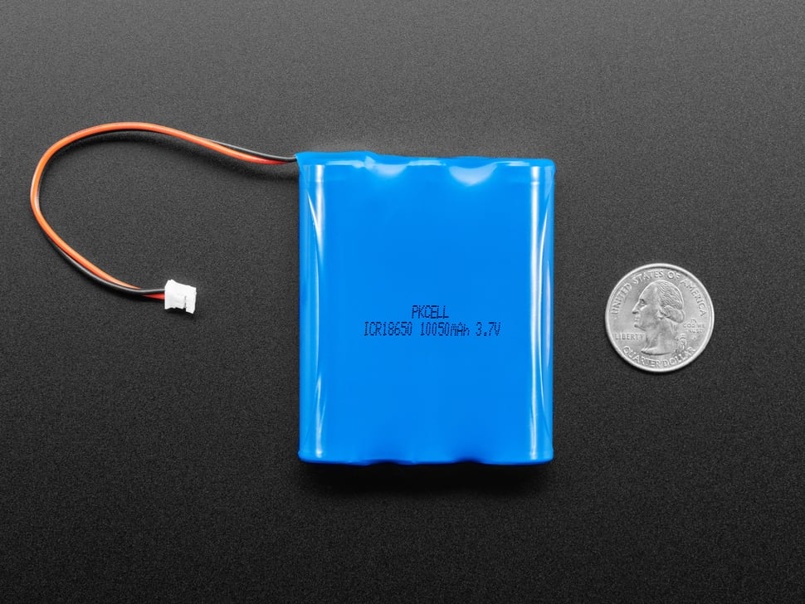
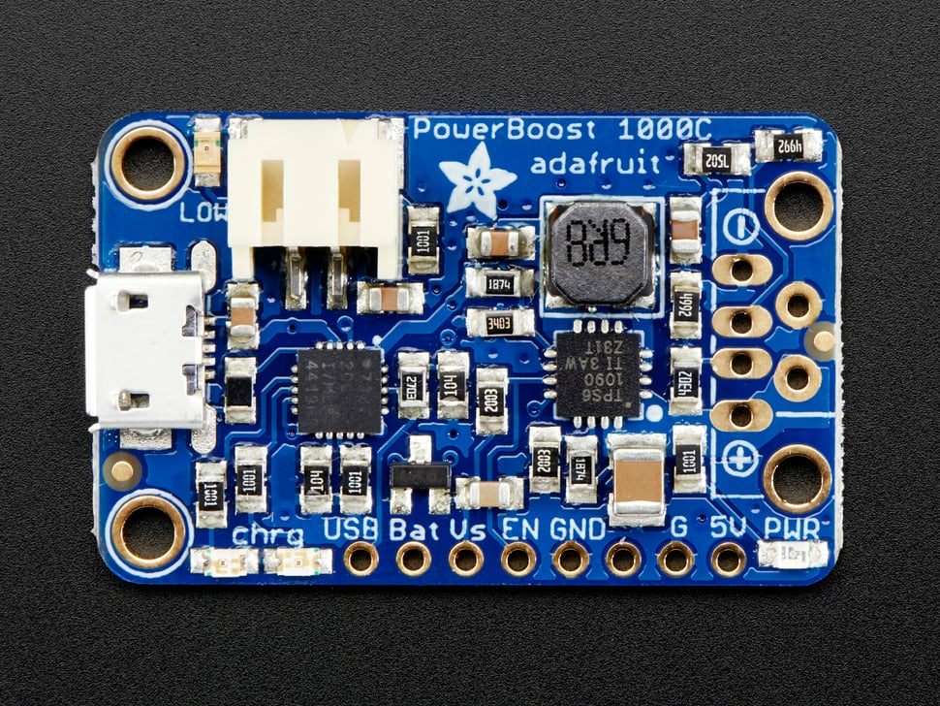
Power Source
3x 18650 Lithium-ion battery pack
10050mAh at 3.7V ~ 37W/hr
overcharge protection at 4.25V
Under discharge protection at 2.5V
Buck-boost nominal 3.7V → stable 5.2V
Micro-USB charging input
Current measured using clamp ammeter
0.44A @ 3.7V = 1.6W
37W/Hr / 1.6W = 23 Hrs Runtime
Notes:
Evan

Slide 20
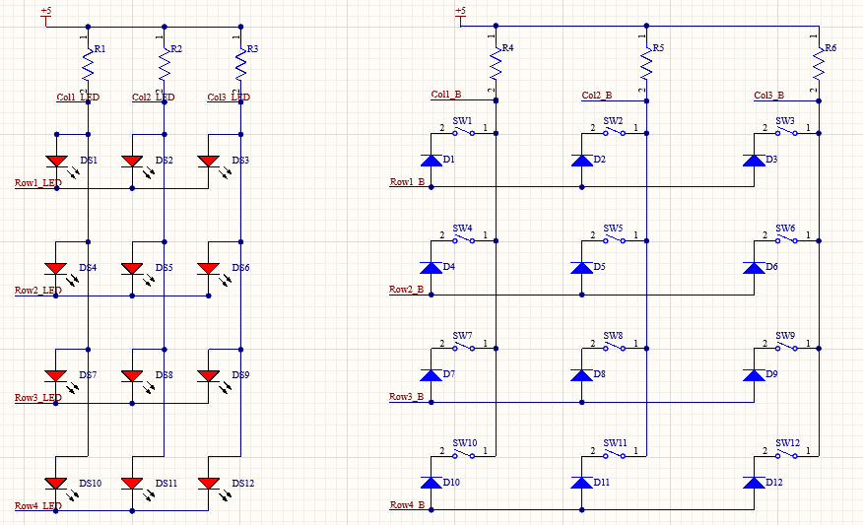
Button PCB
Schematic
Row column addressing
Rows can be linked to connected PCBs together

Slide 21
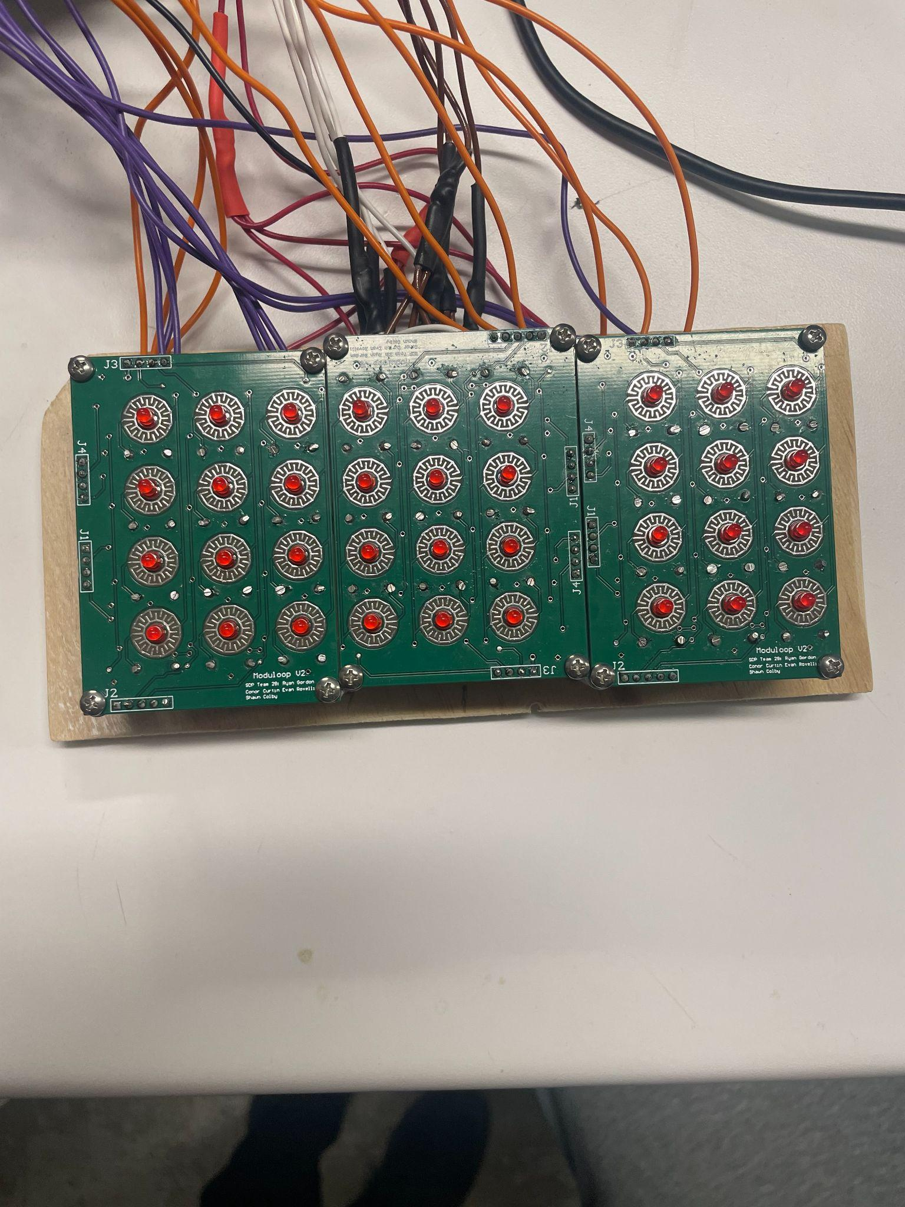
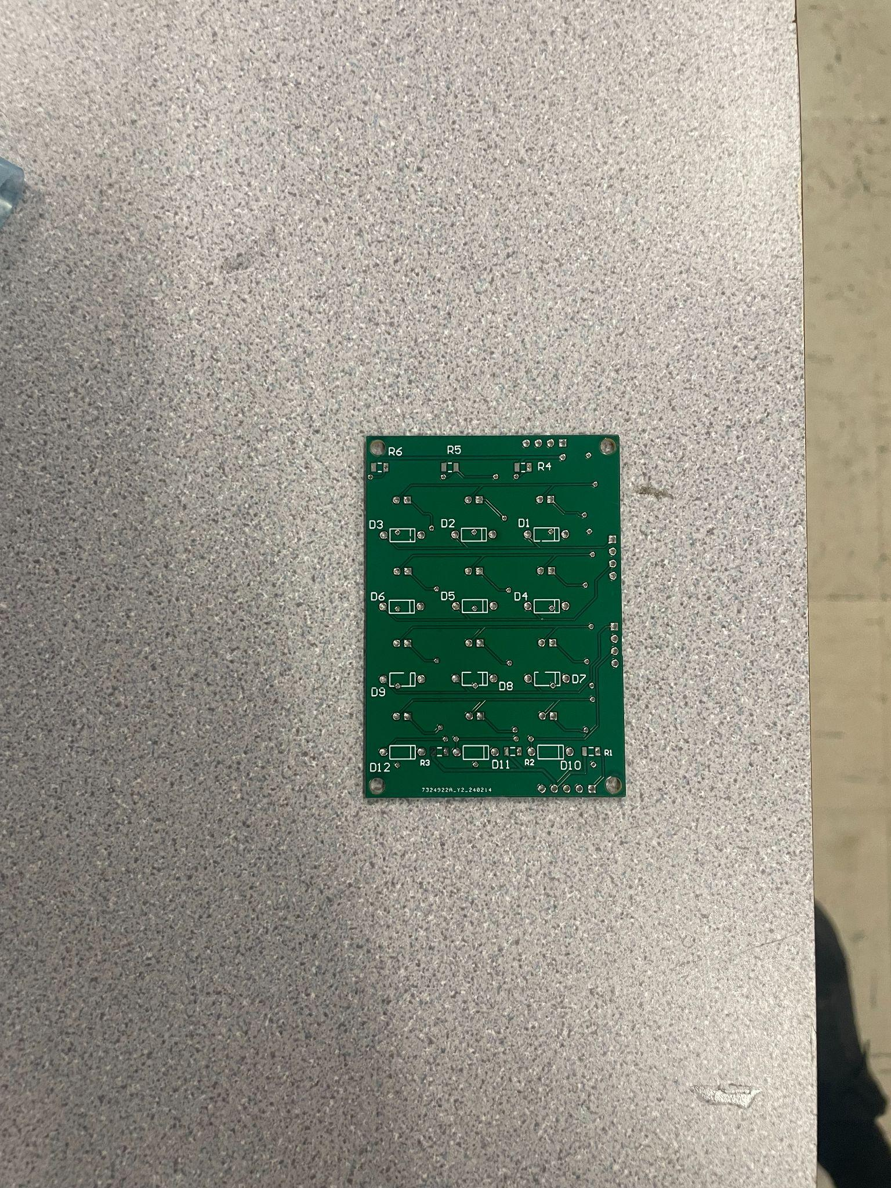
Button PCB

Slide 22
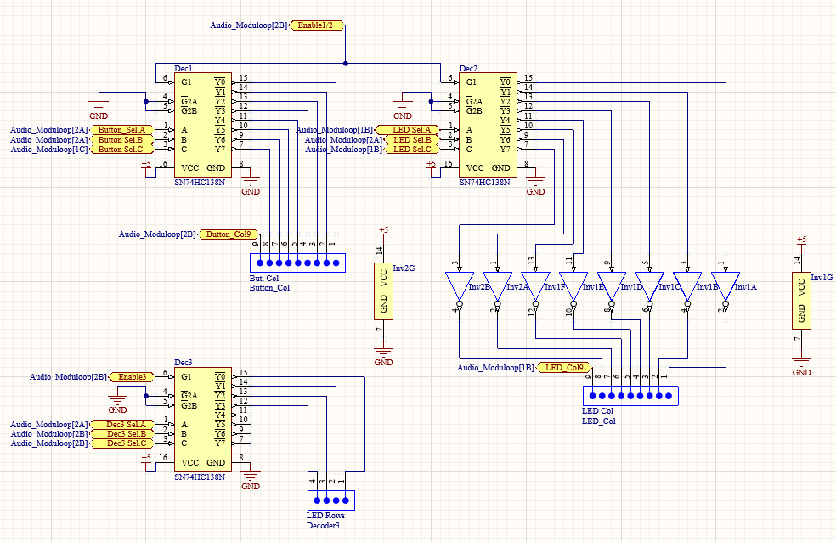
Button Decoders
74HC138N 3-8 decoders used to reduce pins from 26 pins to 18 pins
74HC04N Inverters used to set LED columns high when selected

Slide 23
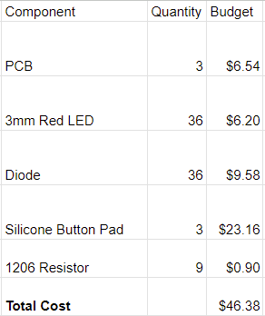
Button PCB BoM

Slide 24
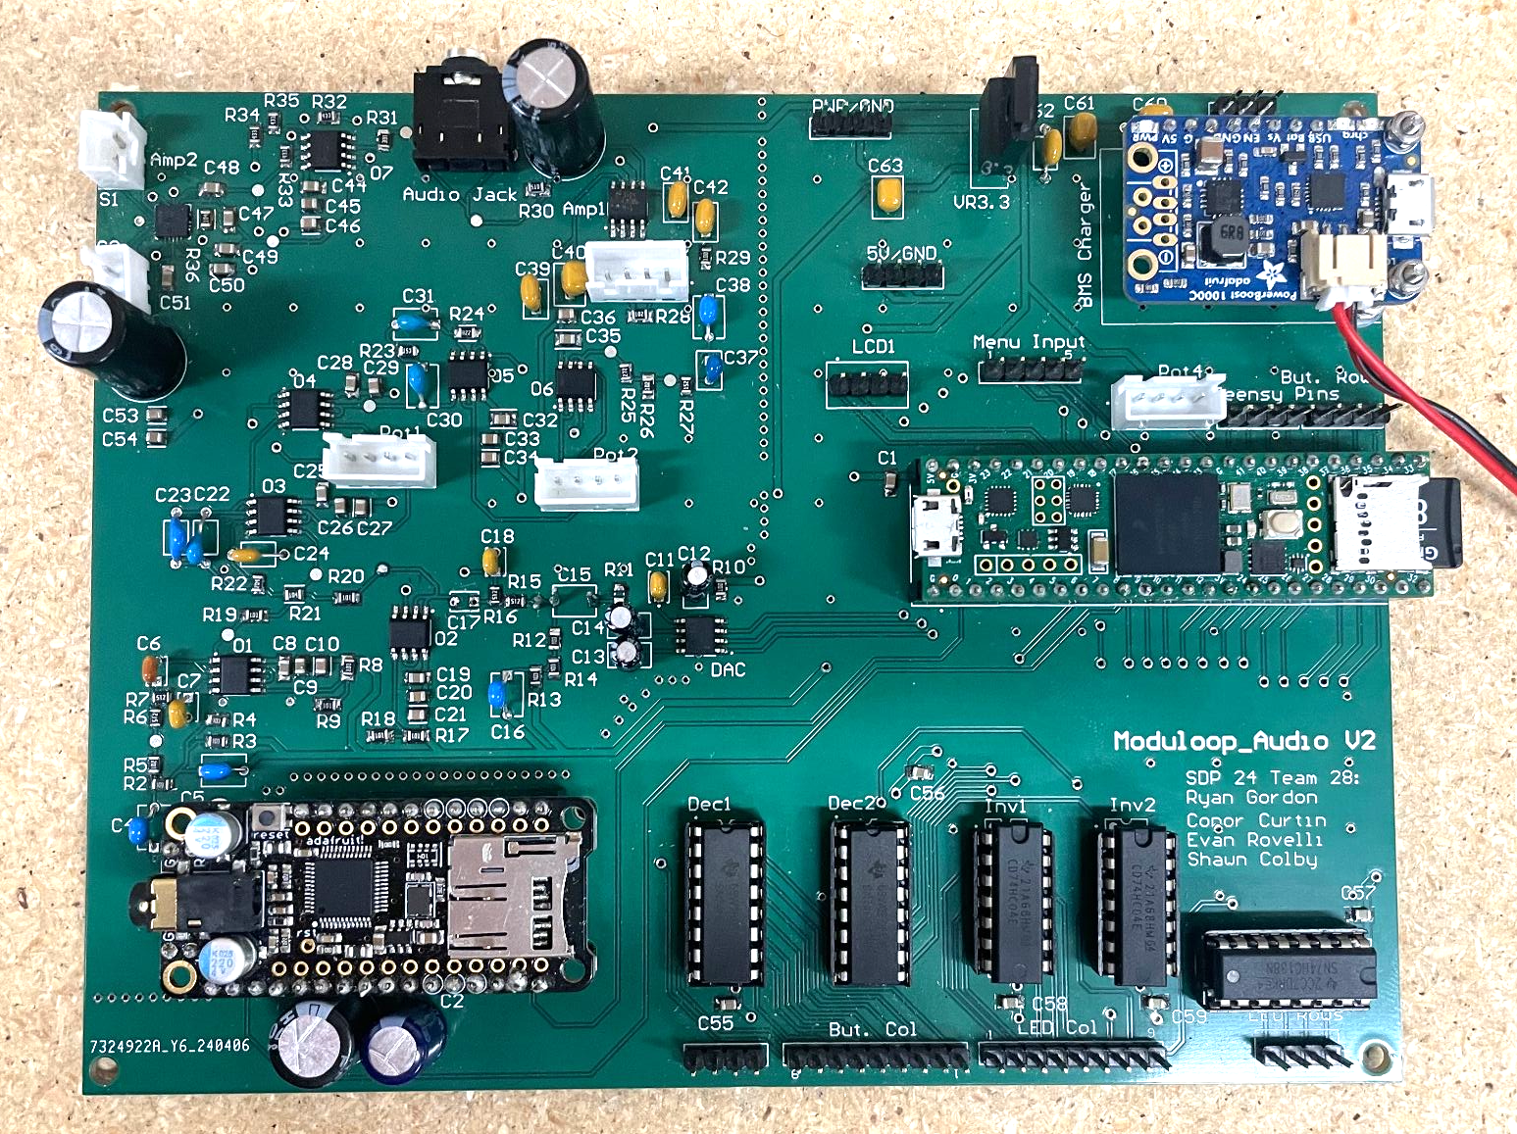
Audio PCB
4-layer mixed signal PCB
Via stitching to section off signal return paths
Updated filter designs
Additional amplifier
Increased decoupling

Slide 25
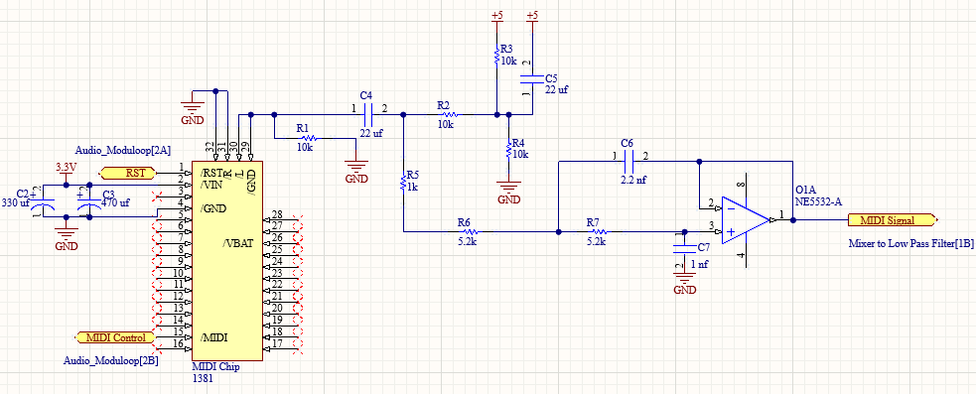
Audio PCB Schematic-MIDI and LP Filter
Notes:
Conor

Slide 26
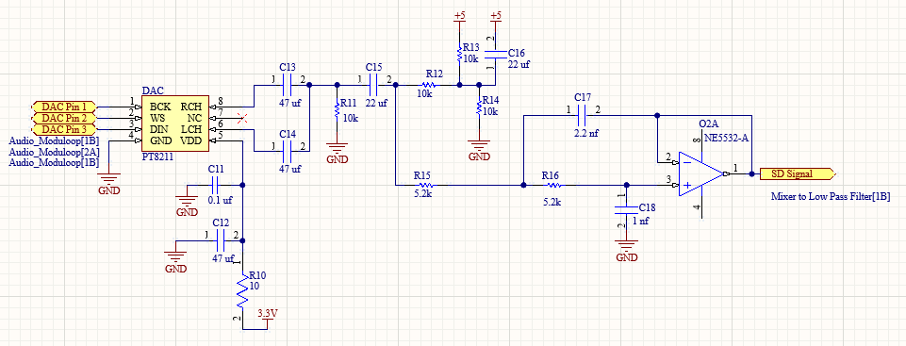
Audio PCB Schematic-DAC and LP Filter
Notes:
Conor

Slide 27
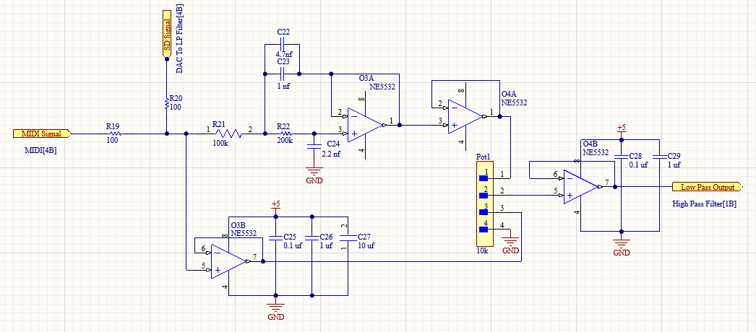
Audio PCB Schematic-Mixer to LP Filter
Notes:
Conor

Slide 28
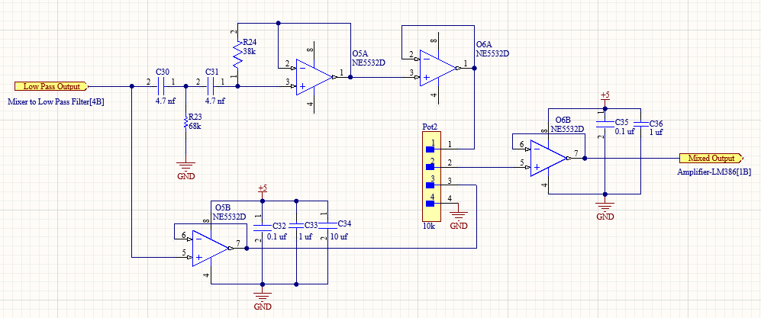
Audio PCB Schematic-HP Filter

Slide 29
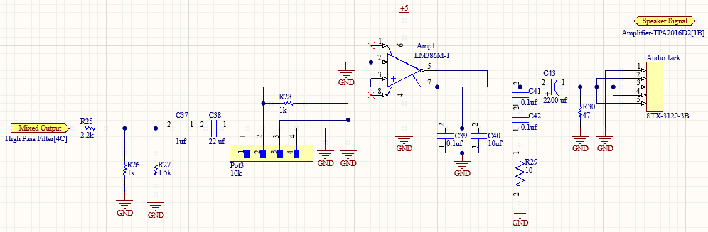
Audio PCB Schematic-Headphone Amplifier
Notes:
Conor

Slide 30
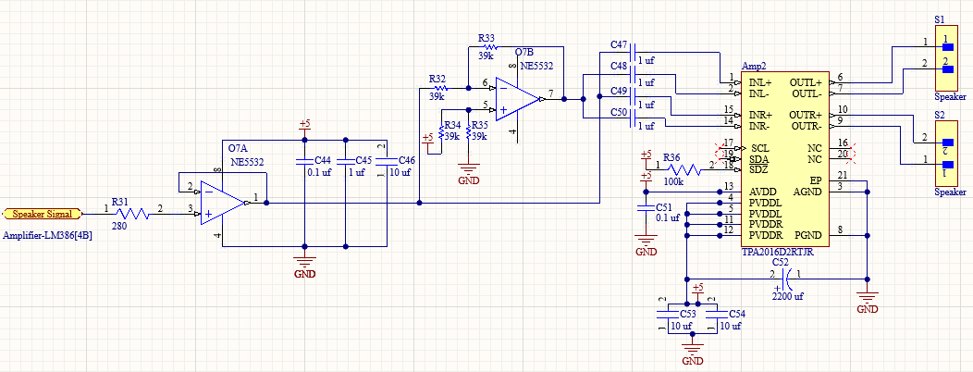
Audio PCB Schematic-Speaker Amplifier

Slide 31
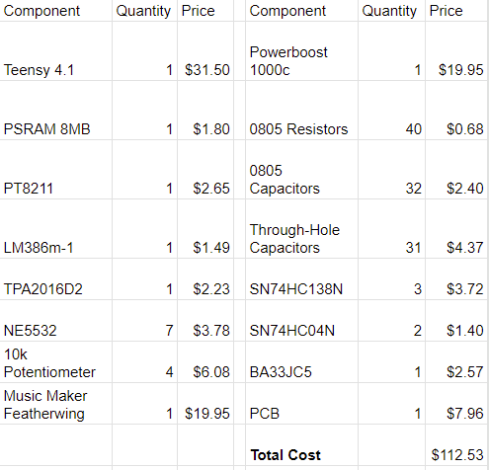
Audio PCB BoM
Notes:
Conor

Slide 32
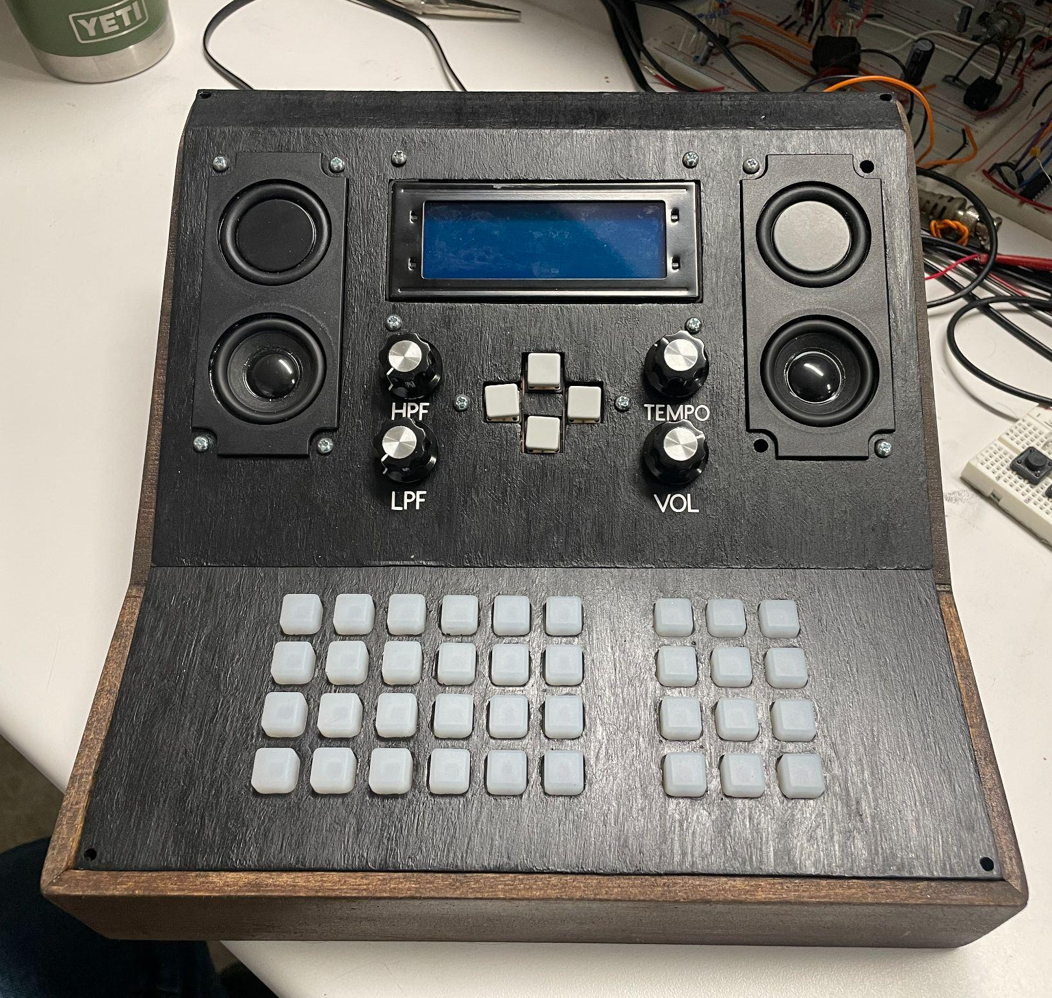
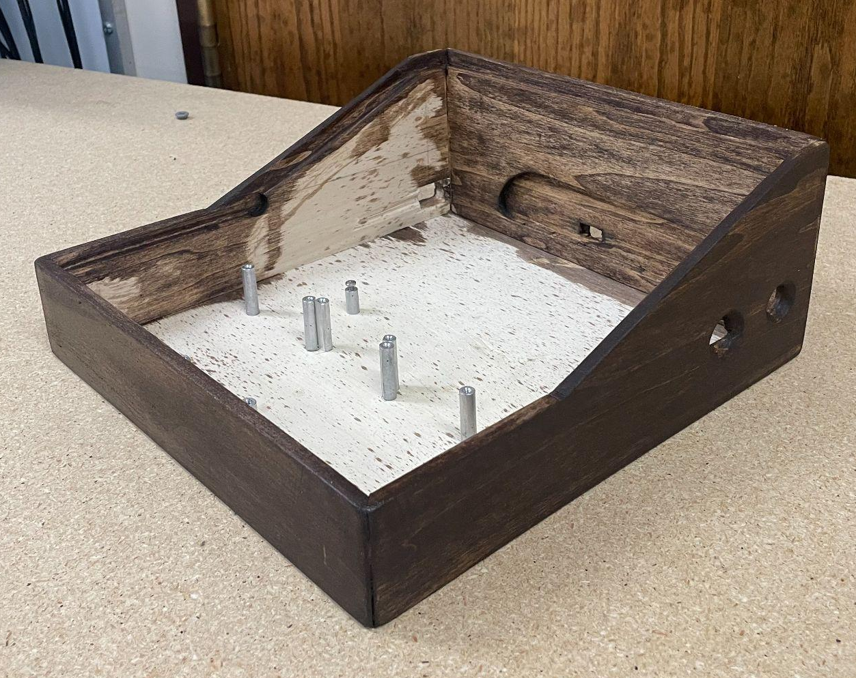
Enclosure
Box made of poplar & plywood
Faceplate is 3D printed, then painted

Slide 33
User Feedback
Positives:
Button pads provide tactile feedback and are similar to other devices in this field
Easy for user to pick up and start making music
Desired Features:
Label measure matrix & palette
Ability to sync with other music software
Logic, Ableton, Pro Tools, etc

Slide 34
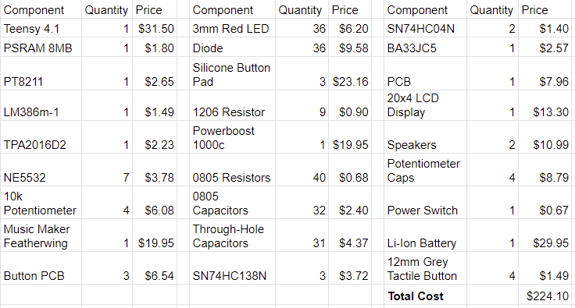
System BoM

Slide 35
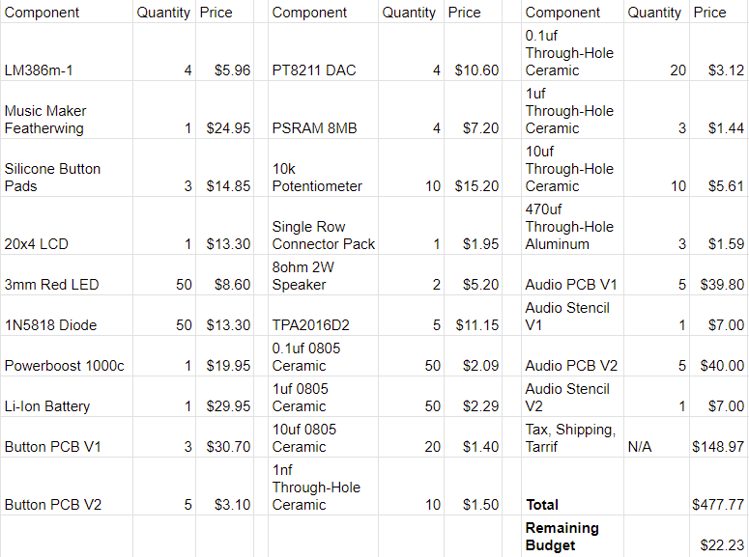
Budget
Notes:
Conor

Slide 36
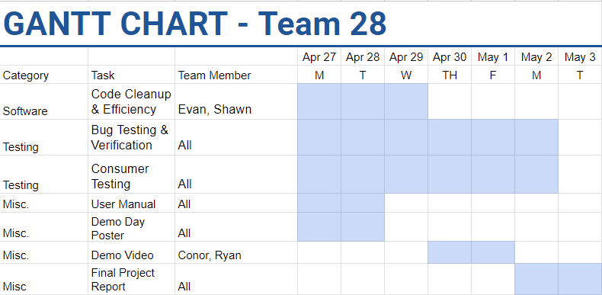
Notes:
Conor
Color-code by person
Fix fonts

Slide 37
Demo

Slide 38
Questions?

Slide 39
Bibliography
[1] A. Industries, “PowerBoost 1000 Charger - Rechargeable 5V Lipo
USB Boost @ 1A.” Accessed: Apr.25, 2024. [Online]. Available: https://www.adafruit.com/product/2465
[2] A. Industries, “Lithium Ion Battery - 3.7V 10050mAh (10 Ah).”
Accessed: Apr. 25, 2024. [Online].Available: https://www.adafruit.com/product/5035

Slide 40
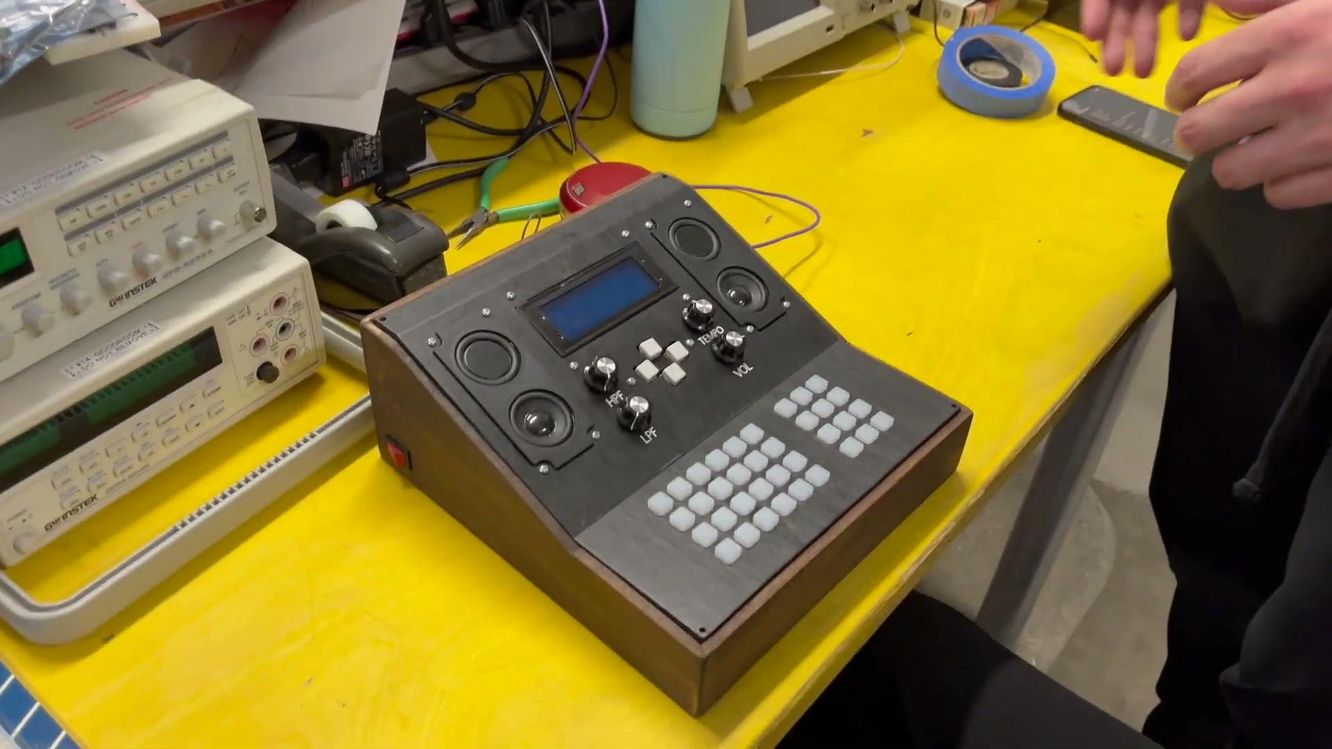
Demo Video

